Slide 1
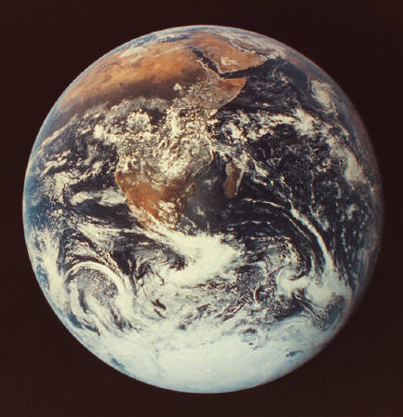
Creation Myths
Innate in human nature is the drive to explore. Chief among these explorations is the desire to explain the origin of man, earth, animals, plants, and other elements of nature.
In an effort to explain these origins, early man invented stories which made sense in regard to his specific time period and culture.
These stories are known today as “Creation Myths.”

Slide 2
Common Themes
Interestingly, Creation Myths from around the world often share many similar themes.
  It is important to remember, however, that these similarities have been attributed by modern scholars, not the inventors of the stories.
  Therefore, individual myths cannot be expected to conform exactly to modern stereotypes.
  Rather, each creation myth will likely contain several common thematic features.
We will attempt to explore these interesting similarities, while also observing any obvious differences.

Slide 3
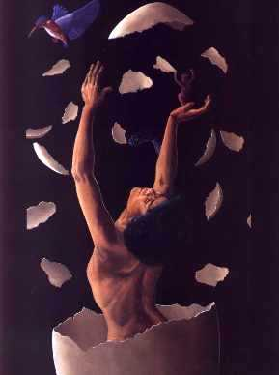
Common Elements:
Birth
Egg
  Often a jumbled mass of components which serve as the first elements of life
Childbirth
  Male or Female gods give birth to children
    Natural
    Unusual

Slide 4
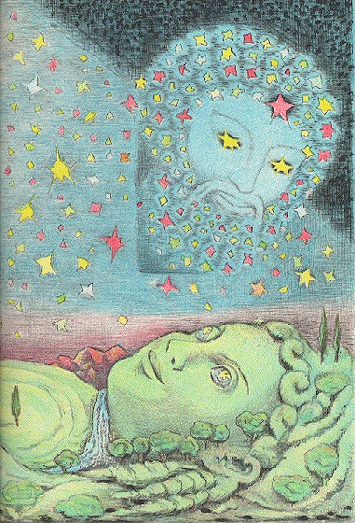
Common Elements:
Mother and Father
Very common in many world cultures
  Mother usually earth
    Life emerges from earth/womb
  Father usually sky
    Sense of unity created (marriage)

Slide 5

Common Elements:
Genealogy
The first god born did not always create the world.
Often, his or her children decided to fill the world with life.
  The parents’ work was finished by the child.

Slide 6
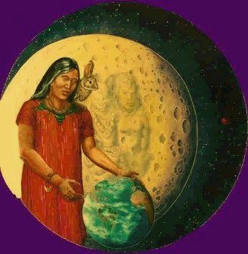
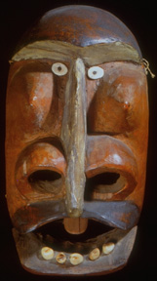
Common Elements:
Supreme Beings
Most cultures revered a pantheon of supreme beings (polytheistic)
Some cultures revered a single creator (monotheistic)

Slide 7
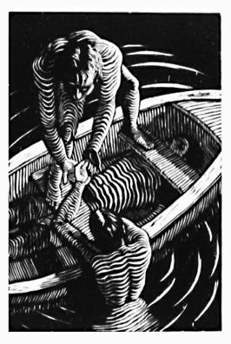
Common Elements:
Earth-Diver Myths
Many stories allude to a time when the earth was covered by water
  many myths feature a creature diving into the water to retrieve some earth to grow and form the Earth

Slide 8
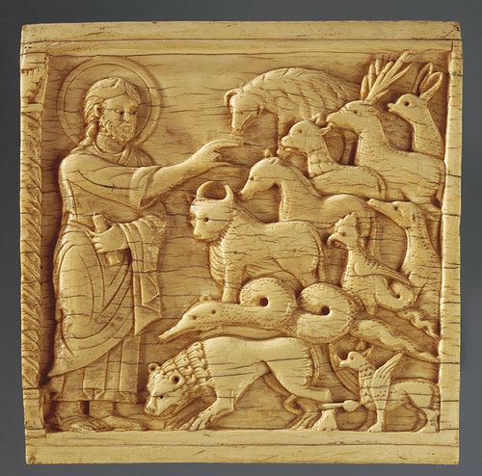
Common Elements:
Animal/Human Relationships
Animals played key roles in many Creation Myths
  often viewed as equal to humans
  often reflect feelings of culture for animals

Slide 9
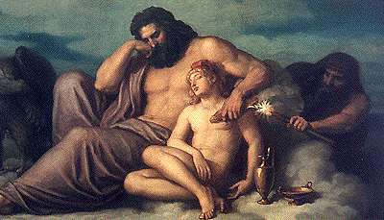
Common Elements:
Night, Fear, Fire, and Sin
In the creation myths of many cultures, darkness represents fear
  the setting of the sun brought on fear and chaos
  this fear and chaos was sometimes represented as fire

Slide 10
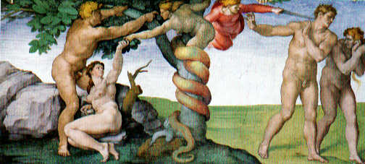
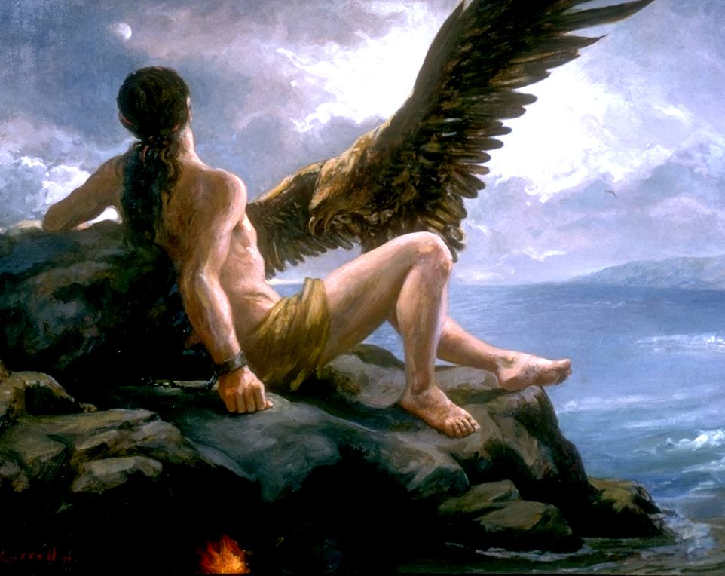
Common Elements:
An Instruction, a Sin, and the Consequence
Many creation myths consist of at least one of these elements
  The consequence is often what causes pain, hunger, disease, and all other evils which plague the earth

Slide 11
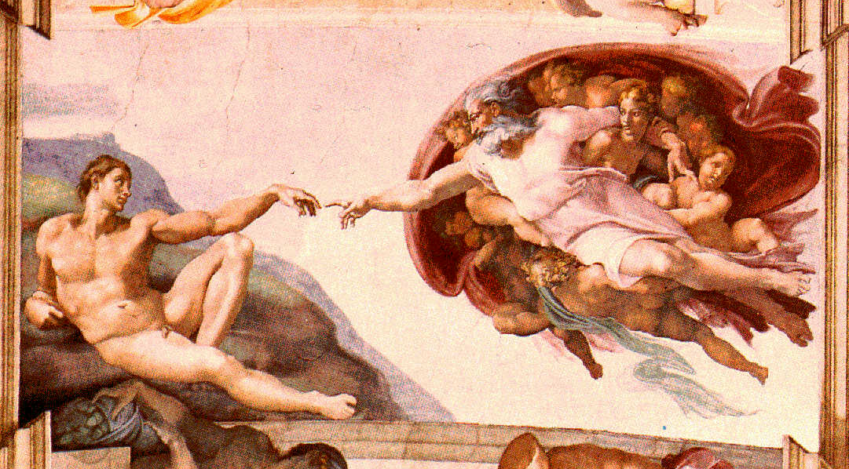
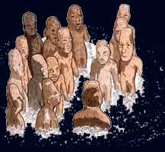
Common Elements:
Creation of Man
Created by a god or supernatural being
Establishes:
  a connection between human beings and the supernatural world
  the place of humans in the hierarchy of life in the universe (below gods, above animals)

Slide 12
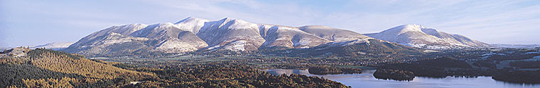
Common Elements:
Creation of Geographical Features
Many legends offer explanations for the formation of mountains, valleys, oceans, rivers, etc.

Slide 13

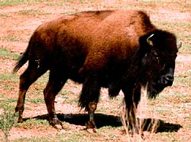
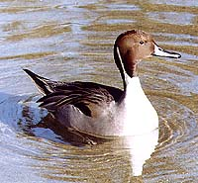
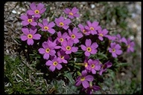
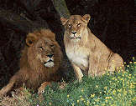
Common Elements:
Creation of Lesser Creatures
(animals, plants insects, etc.)
Almost all creation stories account for the existence of the forms of life that inhabit the planet.
  May also explain the physical characteristics of the animals.

Slide 14
Creation Myths
Much like our distant ancestors, we strive to uncover our origins and determine our place in the universe.
Scientists advance new theories each year on the origin of the universe
  For some, scientific evidence serves as a basis for creation stories
  For others, deeply rooted ancient beliefs remain the cornerstone in their own theories

